Slide 1
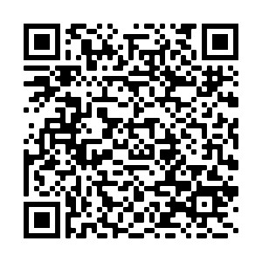
Virtual Design Public Hearing
Resurfacing and Related Work – Route 16
What is happening?
A Live Virtual Design Public Hearing will be hosted on the MassDOT website below to present the design for the proposed Resurfacing and Related Work – Route 16 project in Mendon, MA. How will this affect you?
The hearing is to provide the public with the opportunity to become fully acquainted with the proposed Resurfacing and Related Work – Route 16 project. All views and comments submitted in response to the hearing will be reviewed and considered to the maximum extent possible.
When
September 22, 2022
7:00 PM
Attend
www.mass.gov/massdot-highway-design-public-hearings
Please note this meeting will be transcribed by a stenographer.
Visit www.mass.gov/massdot-highway-design-public-hearings for more information.
This meeting is accessible to people with disabilities and those with limited English proficiency. MassDOT provides reasonable accommodations and/or language assistance free of charge upon request, as appropriate. To request accommodation or language assistance, please contact MassDOT’s Chief Diversity and Civil Rights Officer by phone (857) 368-8580, fax (857) 368-0602, relay 7-1-1, or by email to MassDOT.CivilRights@dot.state.ma.us. Requests should be made as soon as possible prior to the meeting, and for more difficult to arrange services including sign-language, CART or language translation or interpretation, requests should be made at least ten business days before the meeting.
Project inquiries may also be emailed to MassDOTProjectManagement@dot.state.ma.us Please submit any written statements regarding the proposed undertaking to: Carrie A. Lavallee, P.E., Chief Engineer, MassDOT, 10 Park Plaza, Boston, MA 02116, Attention: Project Management, PROJECT FILE NO. 608491

